Slide 1

Computing survival probabilities with Zero Noise Extrapolation in Amazon Bracket
Rajesh Sathya Kumar

Slide 2
Zero Noise Extrapolation - Recap
Create a family of equivalent circuits using Unitary folding (Mirror Circuits)
Run the circuit in a noisy device such that it scales as g = s * g0, where s is the scaling factor and g0 is the initial error, and s >=0
We finally extrapolate the value when s = 0 to determine the error free state

Slide 3
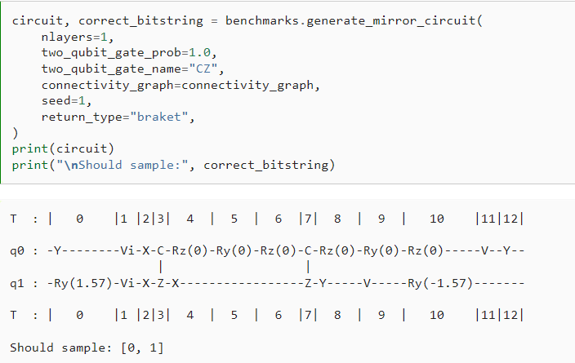
Create Family of equivalent Circuit / Mirror Circuits using mitiq (with one layer)

Slide 4
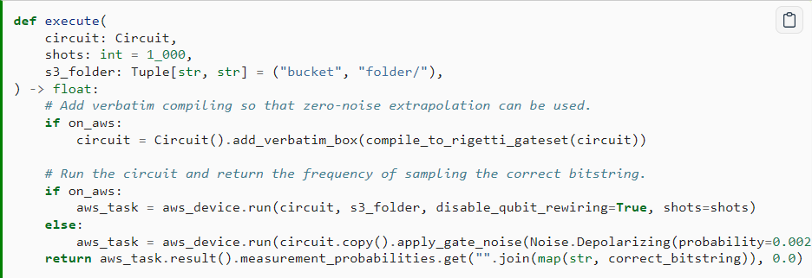
Execution in a noisy circuit
Single Qubit noise as 0.002
Shots: 1000

Slide 5
Results
Noise after circuit execution:
noisy_value = execute(circuit)
print("Noisy value:", noisy_value)
Noisy value: 0.965
Error Mitigation with ZNE:
zne_value = zne.execute_with_zne(
circuit,
execute,
scale_noise=zne.scaling.fold_global,
factory=zne.inference.PolyFactory(scale_factors=[1, 3, 5], order=2)
)
print("ZNE value:", zne_value)
ZNE value: 1.0218749999999988 (Close to 1.0, noise-free the system is)

Slide 6
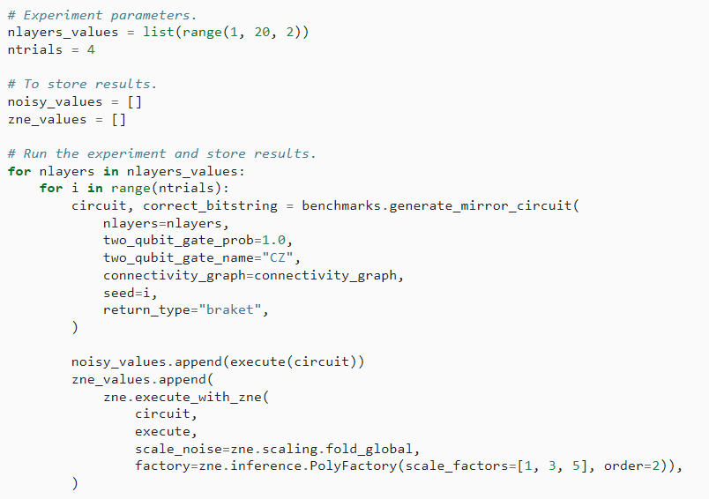
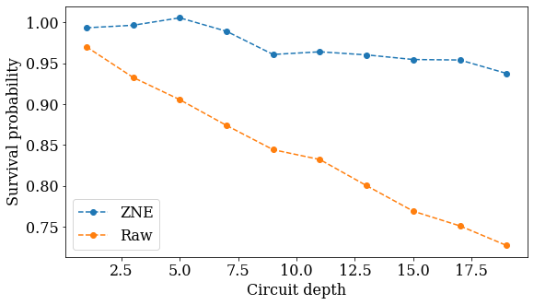
Survival Probability with multiple layers

